Slide 1
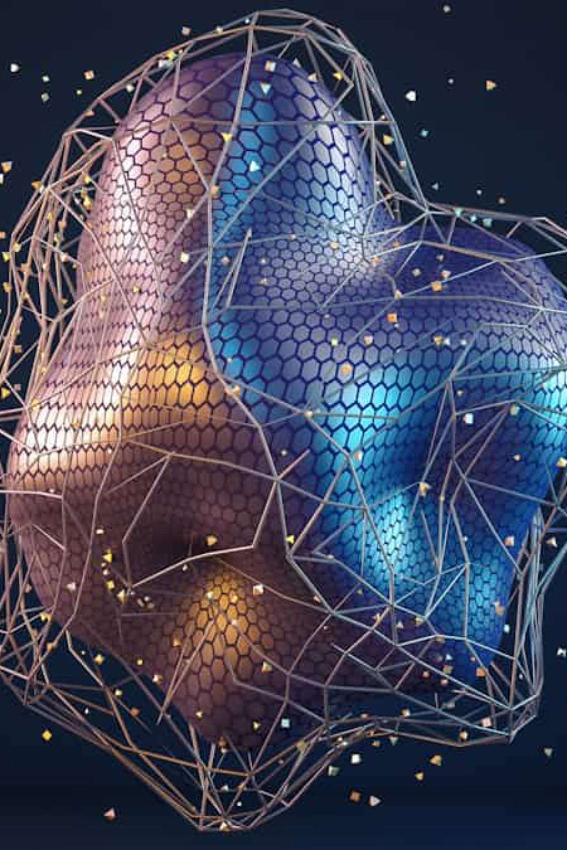



Artificial Intelligence: Key Technologies, Use Cases & Career Opportunities
Exploring the transformative world of AI—from foundational technologies to real-world applications and emerging career pathways in India and beyond.

Slide 2





What is AI? Understanding the Fundamentals
Artificial Intelligence Defined
Artificial Intelligence refers to computer systems designed to mimic human cognitive functions—learning, reasoning, problem-solving, and decision-making. At its core, AI enables machines to analyse data, recognise patterns, and improve performance over time without explicit programming.
Learns from Data
AI systems improve accuracy through continuous data exposure
Machine Learning: The Engine of AI
Machine Learning (ML) is a subset of AI that allows systems to learn from experience. Instead of following pre-programmed rules, ML algorithms identify patterns in data and make predictions or decisions based on those insights.
Automates Tasks
Reduces human effort in repetitive and complex processes
Enables Innovation
Powers breakthrough solutions across industries worldwide

Slide 3

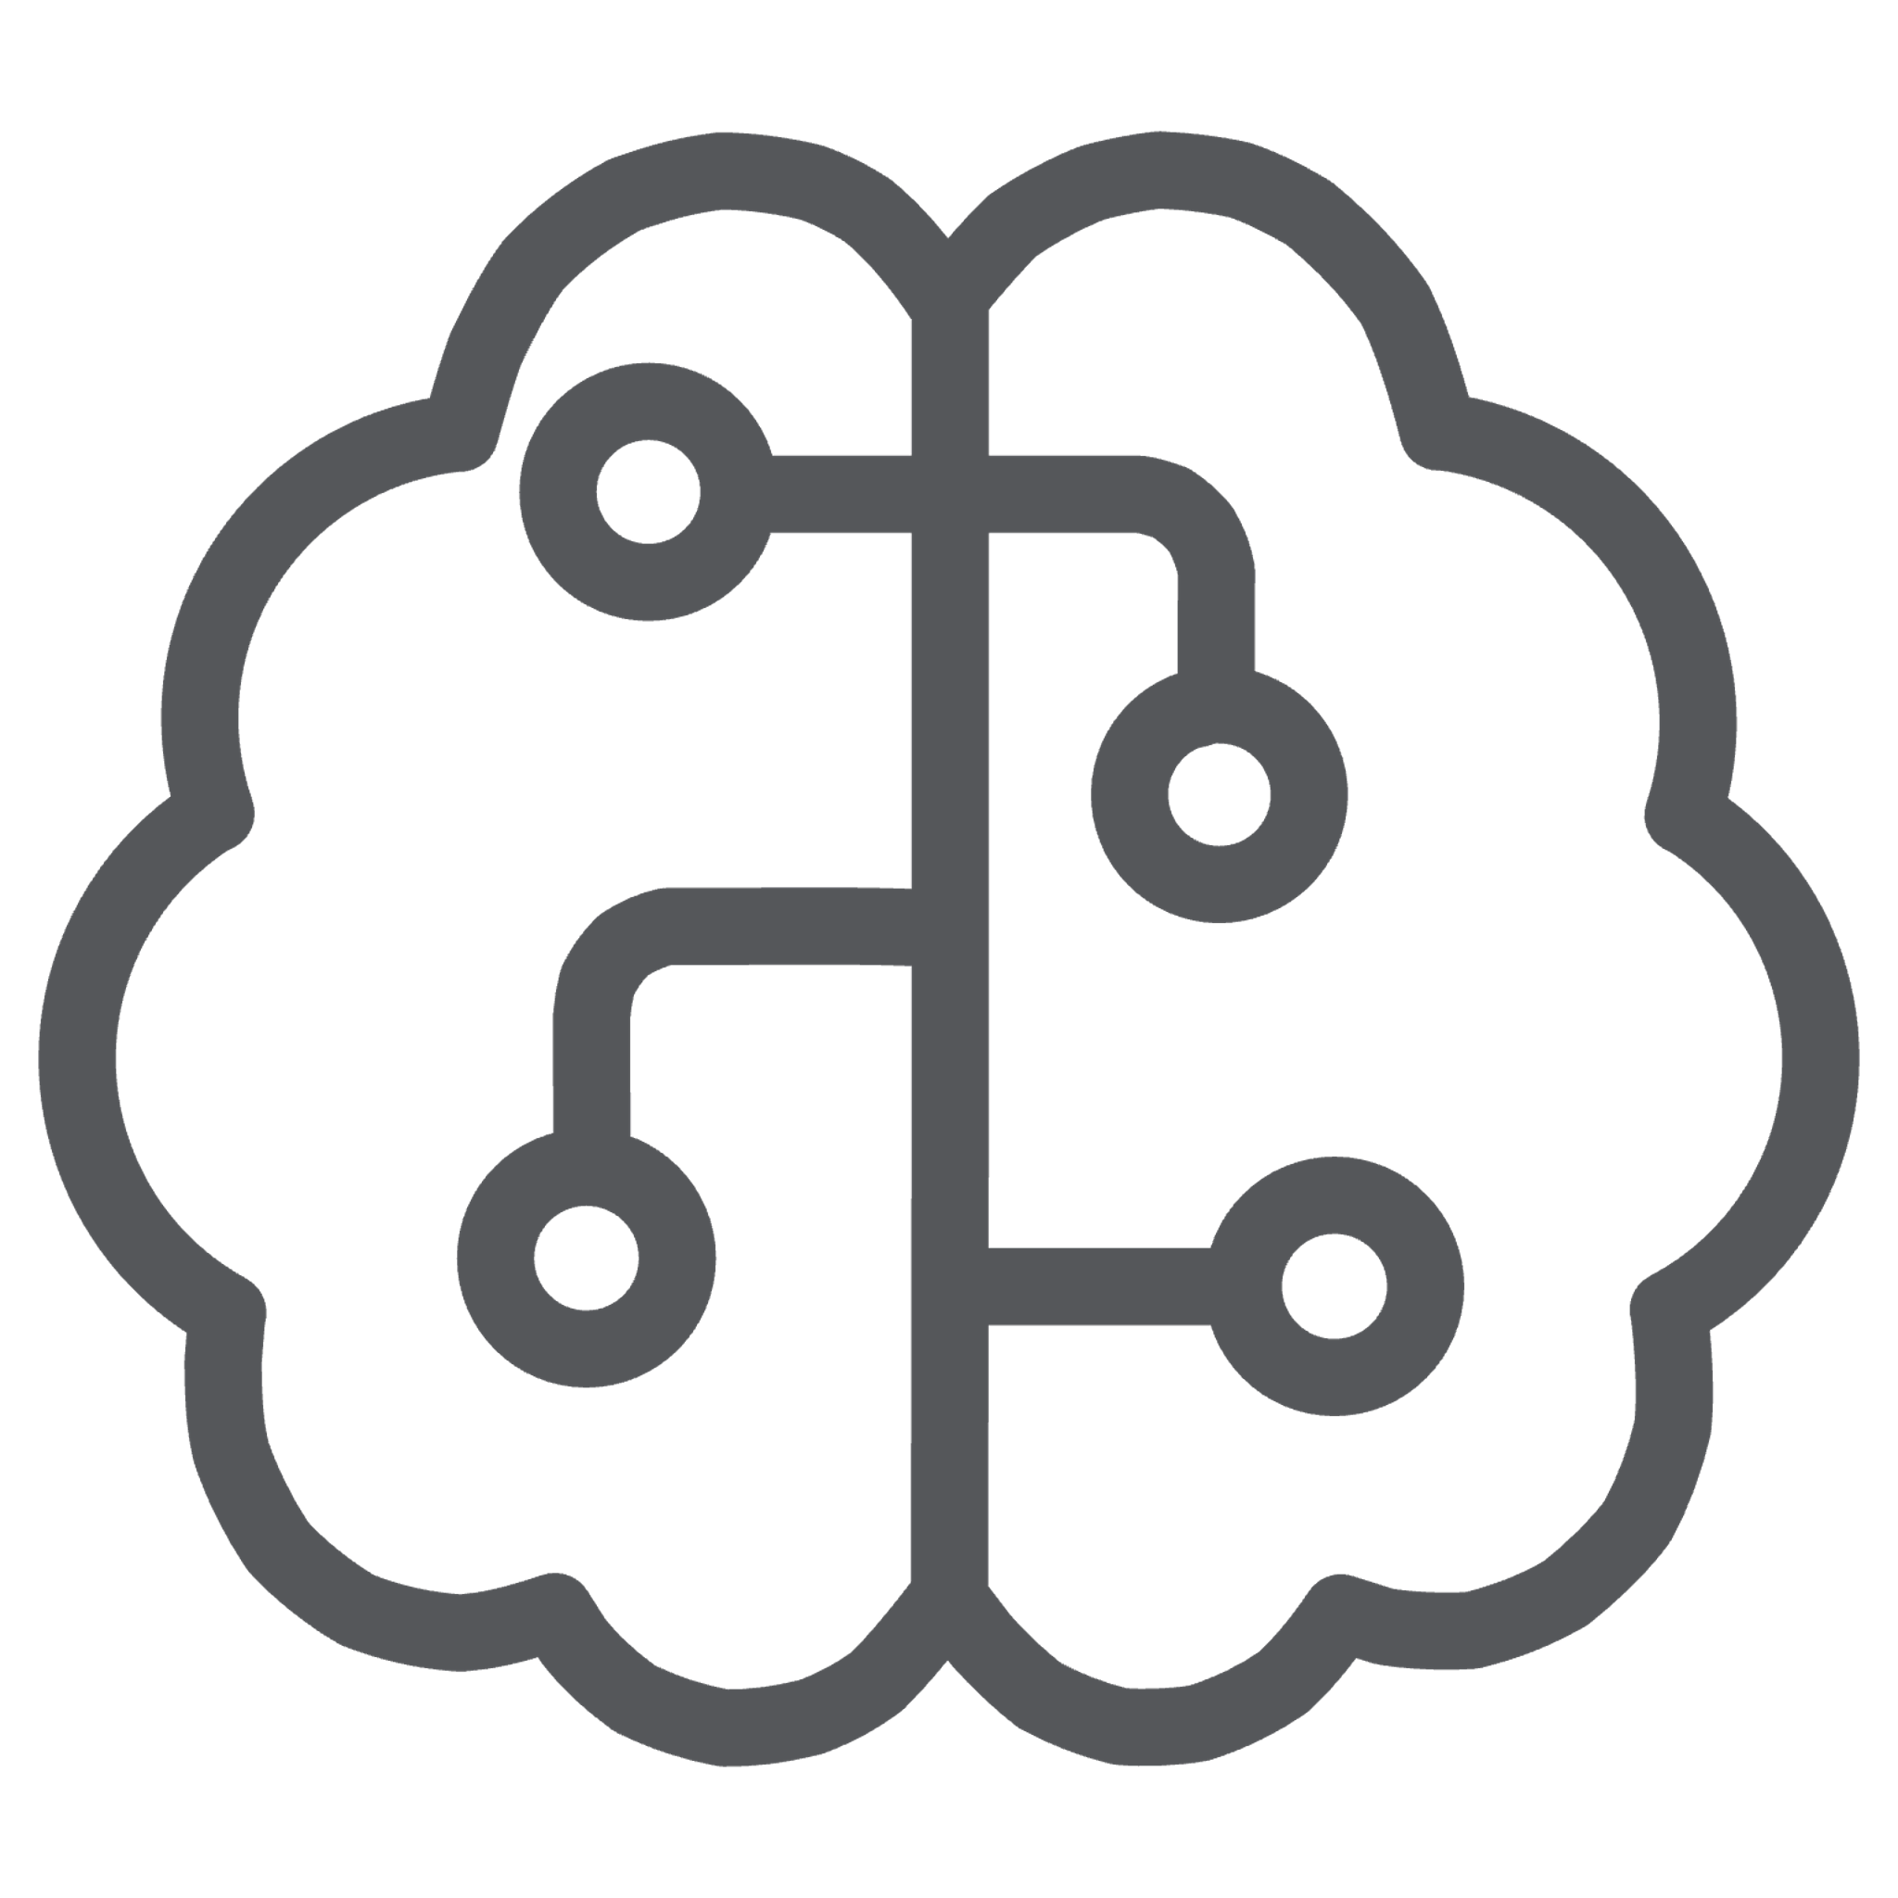


Core AI Technologies
Machine Learning
Algorithms that enable computers to learn from data and improve predictions over time. ML powers recommendation systems, fraud detection, and predictive analytics across industries.
Deep Learning
A subset of ML using multi-layered neural networks to process complex data like images, audio, and video. Deep learning drives breakthroughs in facial recognition and autonomous vehicles.
Natural Language Processing
Technology enabling machines to understand, interpret, and generate human language. NLP powers chatbots, voice assistants, translation services, and sentiment analysis tools.
Computer Vision
Systems that enable machines to interpret and understand visual information from the world. Computer vision is essential for medical imaging, quality control, and security surveillance.

Slide 4
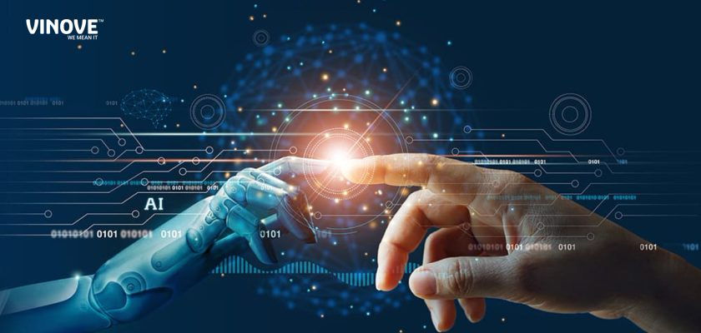
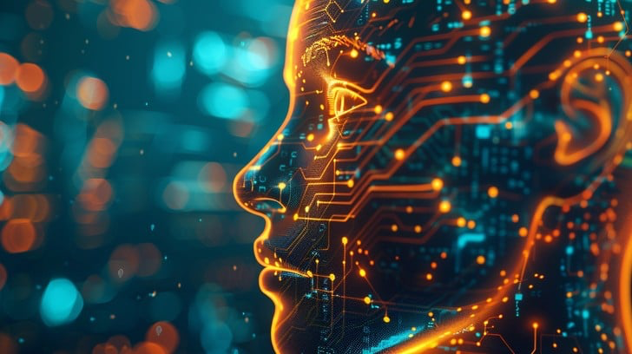

Key Technolog
Transformers & Large Language Models (LLMs) — foundation for modern NLP, chatbots, summarization, code generation.
Deep learning frameworks — PyTorch, TensorFlow and their ecosystems for research & production.
Model hubs & tooling — Hugging Face model/dataset hub, pretrained weights, pipelines for fast prototyping.
MLOps / deployment — CI/CD for models, model serving, monitoring, model versioning and reproducible pipelines.
Data engineering & feature stores — scalable data pipelines, cleaning, labeling, feature stores for model reliability.
Edge & on-device AI — quantization, model compression, inference on mobile/IoT devices.

Slide 5

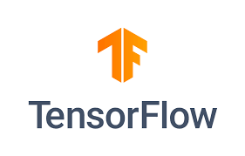



Major AI Platforms and Tools Powering the Industry
TensorFlow
Google's open-source framework for building ML models, widely used for deep learning research and production
PyTorch
Facebook's flexible deep learning library, preferred by researchers for its dynamic computation graphs
Google Cloud AI
Comprehensive suite of ML services including AutoML, Vision AI, and Natural Language APIs
Microsoft Azure AI
Enterprise-grade AI tools including Cognitive Services, Bot Framework, and Machine Learning Studio

Slide 6


Technical Concepts Every AI Professional Should Master
Neural Networks
Algorithms & Models
Data Processing & Engineering
Computational models inspired by the human brain, consisting of interconnected layers of nodes (neurons) that process information. Neural networks form the foundation of deep learning and enable pattern recognition in complex datasets.
Step-by-step procedures for solving problems and making predictions. Key algorithms include regression, classification, clustering, and reinforcement learning—each suited for different types of AI challenges.
Techniques for collecting, cleaning, transforming, and preparing data for analysis. Quality data processing is crucial—models are only as good as the data they're trained on, making this skill essential for AI success.
Mastering these concepts requires hands-on practice, continuous learning, and staying updated with the latest research and industry trends in artificial intelligence.

Slide 7


AI in India: Aadhaar's Biometric Revolution
Transforming Identity Verification at Scale
India's Aadhaar system represents one of the world's most ambitious AI-powered initiatives. Launched by the Unique Identification Authority of India (UIDAI), it uses sophisticated biometric authentication—combining fingerprint scans, iris recognition, and facial recognition—to provide every resident with a unique 12-digit identity number.
Real-World Impact
Financial inclusion: Enabled 400+ million previously unbanked Indians to access banking services
Subsidy delivery: Reduced leakages in welfare programmes by directly transferring benefits to beneficiaries
1.4B
99%
Authentication: Powers instant digital verification for services from SIM cards to passport applications
Citizens Enrolled
Coverage Rate
Technology showcase: Demonstrates AI's potential to solve large-scale social challenges in developing nations
World's largest biometric identification system
Penetration across India's adult population

Slide 8

Global AI Success Story: ChatGPT & OpenAI
Revolutionising Human-AI Interaction
Content Creation
OpenAI's ChatGPT has emerged as a transformative force in artificial intelligence, demonstrating unprecedented natural language understanding and generation capabilities. Released in November 2022, it reached 100 million users in just two months—the fastest-growing consumer application in history.
Writers, marketers, and creators use ChatGPT to generate articles, marketing copy, and creative content efficiently
Why ChatGPT Matters
Education & Learning
Built on the GPT (Generative Pre-trained Transformer) architecture, ChatGPT showcases the power of large language models trained on vast amounts of text data. It can engage in nuanced conversations, write code, create content, answer complex queries, and assist with problem-solving across countless domains.
Students and educators leverage AI tutoring, explanations, and personalised learning assistance
Business Automation
Companies integrate ChatGPT for customer support, data analysis, and workflow optimisation
Software Development
Developers use AI to write code, debug programmes, and accelerate application development

Slide 9





Career Opportunities in the AI Ecosystem
Data Scientist
Machine Learning Engineer
Role: Extract insights from complex datasets using statistical analysis and machine learning
Role: Design, build, and deploy ML models into production systems at scale
Skills needed: Python/R, statistics, SQL, data visualisation, ML algorithms
Skills needed: TensorFlow/PyTorch, software engineering, cloud platforms, MLOps
Avg. salary in India: ₹8-15 LPA for mid-level professionals
Avg. salary in India: ₹10-18 LPA for experienced engineers
AI Research Scientist
AI Product Manager
Role: Conduct cutting-edge research to advance AI algorithms and methodologies
Role: Bridge technology and business, defining AI product strategy and roadmaps
Skills needed: PhD/Master's in CS/ML, deep learning, research publications, mathematics
Skills needed: Product management, AI/ML fundamentals, stakeholder communication, market analysis
Avg. salary in India: ₹15-30 LPA in top research labs
Avg. salary in India: ₹12-25 LPA depending on experience

Slide 10





Industry Demand and Growth Outlook
Where AI Professionals Are Most Needed
The artificial intelligence sector is experiencing exponential growth globally, with India emerging as a major AI talent hub. The demand for skilled AI professionals far exceeds supply, creating lucrative opportunities across industries.
Technology & IT Services
45%
Companies like TCS, Infosys, Wipro, and global tech giants are aggressively hiring AI talent for product development and client solutions
Banking & Financial Services
BFSI sector leverages AI for fraud detection, risk assessment, algorithmic trading, and personalised customer experiences
Annual Growth
Healthcare & Pharmaceuticals
Expected CAGR in India's AI market through 2027
AI powers diagnostics, drug discovery, patient care optimisation, and medical imaging analysis
E-commerce & Retail
Recommendation engines, demand forecasting, inventory management, and customer service automation drive AI adoption
$500B
Global AI Market
Projected market size by 2028
2.3M
Job Openings
AI-related positions expected globally by 2025
SUBMITTED BY YEHAN YADAV
2501730259 CSE AI/ML
Future outlook: Industry experts predict that AI skills will become as fundamental as programming literacy, with demand continuing to surge across sectors. Professionals who invest in AI education today will be well-positioned for tomorrow's opportunities.

